Slide 1

DEPARTMENT OF CSE(ARTIFICIAL INTELLIGENCE AND MACHINE LEARNING)
AGI1242 – MACHINE LEARNING TECHNIQUES
BATCH - 03
Presented By:
Dharani Indhiran V(2503811714821009)
Dhuhash U (2503811714821010)
Gopika N (2503811714822011)
Gowtham D T (2503811714821012)
Guided By:
Mrs. Ms.S.Murgavlli
ASSISTANT PROFESSOR / AI

Slide 2


Traffic Congestion Prediction And Prevention System Using K-Means

Slide 3
PRESENTATION OVERVIEW
Objective
Problem Statement
Literature Survey
System Architecture Diagram
Existing System
Proposed System
Identified Modules
Algorithms Used
Implementation and Results
Performance Evaluation
Optimization Techniques
Limitations and Future Enhancements
Conclusion

Slide 4
OBJECTIVE
Analyze traffic data to understand traffic flow and congestion patterns.
Apply K-Means clustering to group similar traffic conditions.
Classify congestion levels such as low, medium, and high.
Identify congestion-prone areas and locations.
Detect peak congestion periods and high-risk time slots.
Predict potential congestion based on identified traffic patterns.
Support preventive measures to improve traffic flow.
Reduce travel delays and improve overall transportation efficiency.

Slide 5
Problem Statement
Increasing vehicle density causes heavy traffic congestion.
Limited road capacity leads to traffic bottlenecks.
Accidents and unexpected events can worsen congestion.
Traditional systems are mostly reactive and respond after congestion occurs.
Recurring traffic patterns are not effectively identified.
Machine Learning is needed to analyze large amounts of traffic data.
K-Means clustering can identify different traffic patterns and congestion levels.
The system can help detect congestion-prone conditions in advance.
Supports preventive traffic management and better road utilization.
Aims to reduce travel delays and improve traffic flow.

Slide 6
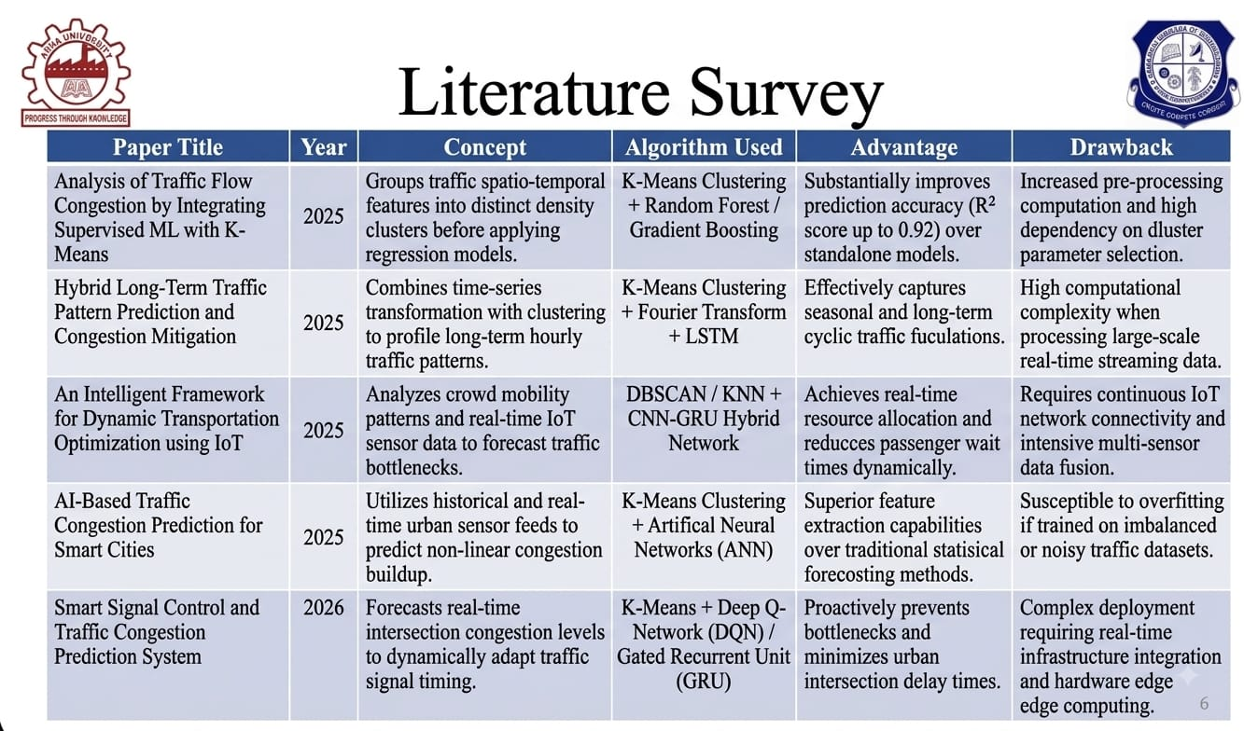
Literature Survey
Paper Title | Year | Concept | Algorithm Used | Advantage | Drawback

Slide 7
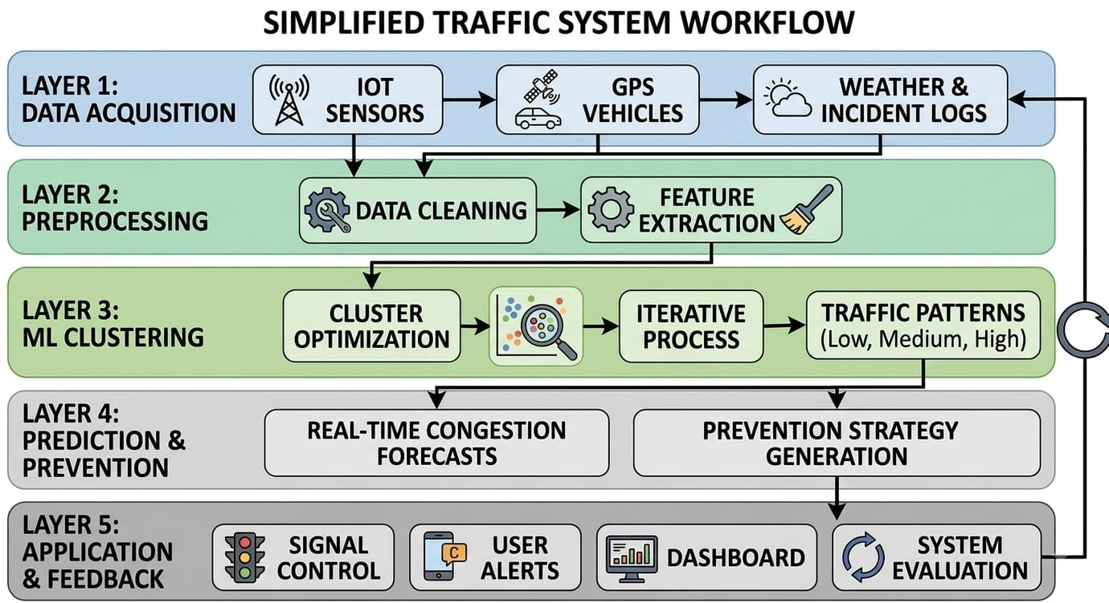
System Architecture Diagram

Slide 8
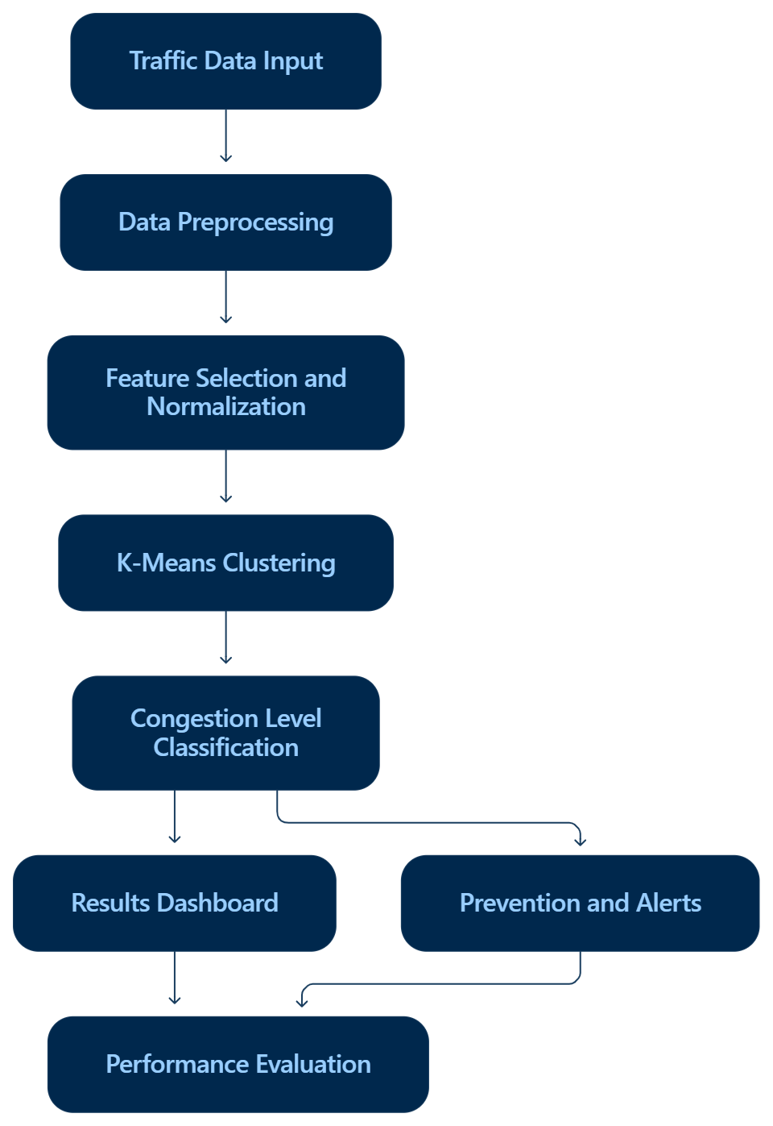
System Architecture Diagram

Slide 9
Existing System
Existing traffic congestion systems use sensors, GPS, cameras, and historical traffic data to monitor vehicle speed, traffic volume, and road density.
Machine learning techniques such as K-Means, KNN, LSTM, and GRU are used to identify traffic patterns and predict congestion levels.
Some systems provide traffic visualization and congestion alerts.
Advanced approaches may require large datasets and considerable computational resources.
Traditional reactive approaches may identify congestion only after it develops.

Slide 10
Existing System Drawbacks
High computational requirements for deep-learning and hybrid models.
Requires large amounts of historical and real-time traffic data.
Some systems are complex to implement and maintain.
Traditional systems may respond after congestion has already occurred.
K-Means requires the number of clusters (K) to be selected beforehand.

Slide 11
Proposed System
The proposed system uses the K-Means clustering algorithm to analyze traffic data such as vehicle count, speed, traffic density, road occupancy, time, and location.
The collected data is preprocessed and grouped into different traffic conditions such as Low, Moderate, High, and Severe congestion.
The system identifies congestion-prone areas and provides early alerts and preventive suggestions, such as alternate routes or traffic management actions.
This approach provides a simple, efficient, and interpretable machine-learning solution for predicting and preventing traffic congestion.

Slide 12
Benefits of Proposed System
High computational requirements for deep-learning and hybrid models
Requires large amounts of historical and real-time traffic data
Some systems are complex to implement and maintain
Traditional systems may respond after congestion has already occurred
K-Means requires the number of clusters (K) to be selected beforehand
Improved traffic management – supports better traffic-control decisions
Cost-effective – works with commonly available traffic data
Scalable system – extendable to multiple roads and locations
Better road utilization – distributes traffic more efficiently

Slide 13
Identified Modules
Traffic Data Collection Module
Data Preprocessing Module
K-Means Clustering Module
Congestion Prediction Module
Prevention & Alert Module

Slide 14
Algorithms Used
K-Means Clustering Algorithm
K-Means is used to group traffic data into similar congestion patterns based on vehicle count, speed, density, and road occupancy. The algorithm divides the data into clusters representing Low, Moderate, High, and Severe congestion. Based on the identified cluster, the system predicts traffic conditions and provides early alerts and preventive suggestions to reduce congestion.

Slide 15
Implementation and Results
Application workflow:
Open the deployed project application.
Enter or load the available traffic data.
Process and prepare the input features.
Run the K-Means clustering algorithm.
Group the observations based on their feature similarity.
Map the resulting clusters to traffic congestion levels.
Display the results through the application interface.
Review any available congestion alerts or preventive suggestions.

Slide 16
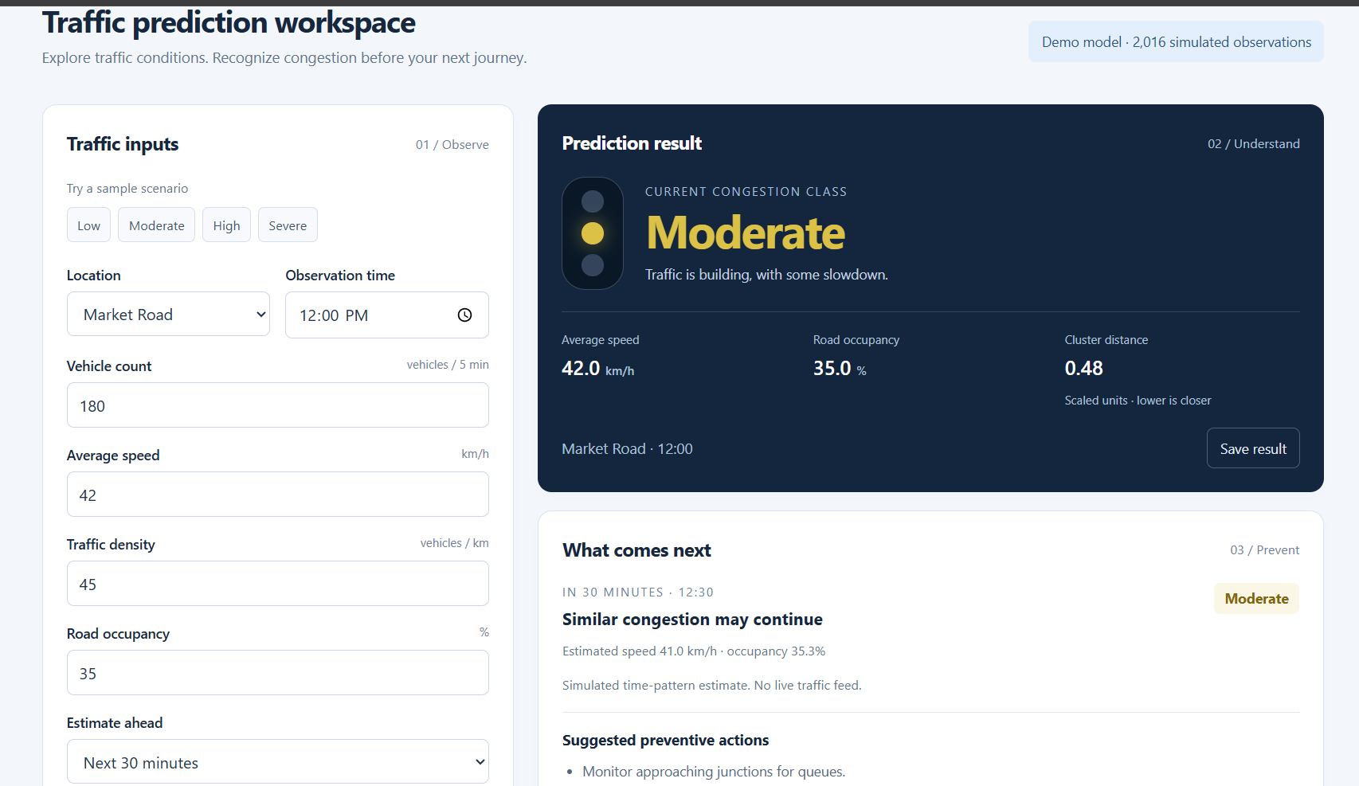
Screenshot

Slide 17
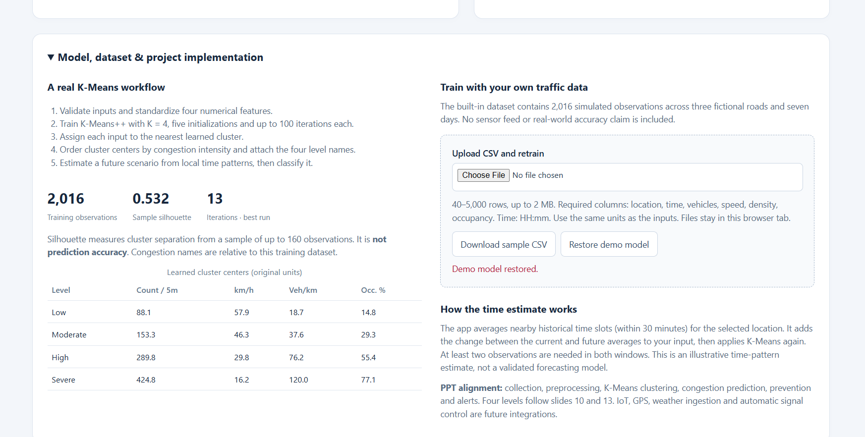
Screenshot

Slide 18
Performance Evaluation
The following metrics can be used to evaluate the implemented clustering model.
Metric | Purpose
Silhouette Score | Evaluates cluster separation and cohesion
Inertia | Measures within-cluster squared distances
Execution Time | Measures how quickly clustering completes
Cluster Distribution | Shows the number of observations in each cluster

Slide 19
Optimization Techniques
Data cleaning: Handle missing and inconsistent traffic values.
Feature normalization: Reduce the influence of different numerical scales.
Feature selection: Use relevant traffic variables.
Centroid initialization: Consider K-Means++ to improve initialization.
Cluster evaluation: Compare suitable values of K using clustering metrics.
Efficient processing: Avoid unnecessary repeated data transformations.
Performance validation: Compare execution time and clustering quality before and after changes.

Slide 20
Conclusion
The project demonstrates the use of machine learning for traffic analysis.
K-Means identifies groups of similar traffic observations.
The resulting clusters can represent Low, Moderate, High and Severe congestion.
Traffic visualizations help users understand congestion patterns.
Congestion analysis can support preventive traffic-management decisions.
The approach is simple, interpretable and suitable for further development.
Future work can improve real-time data integration, route recommendations and model evaluation.

Slide 21
Limitations and Future Enhancements
Limitations
K-Means needs the number of clusters in advance.
Results depend on the quality of traffic data.
Data must be properly scaled.
Accidents need extra information to be detected.
Real-time prediction needs updated traffic data.
Route suggestions need road and traffic information.
Traffic clusters must be checked and labelled correctly.
Future Enhancements
Use live traffic data from GPS and IoT sensors.
Include weather and accident details.
Cover more roads and locations.
Send alerts through a website or mobile app.
Suggest better routes.
Compare K-Means with other ML algorithms.
Improve traffic signals using predictions.
Test the system with more traffic data.

Slide 22
THANK YOU

